Slide 1


Python programming
Algorithms

Slide 2
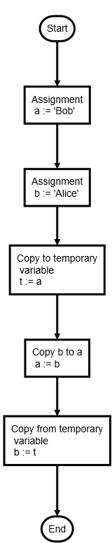
Algorithms
A set of instructions to solve a problem
Computer programs are texts that instruct the computer to manipulate data in a particular way.
For example swapping the contents of two variables.
Notes:
Please do not reduce the font size as this is the recommended size for mobile phone users.
2

Slide 3
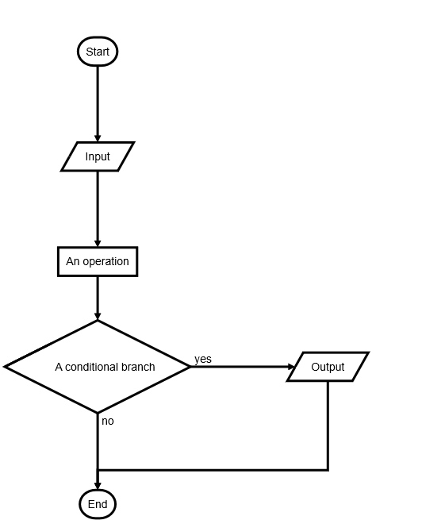
Algorithms
Flowcharts
Flowcharts are not as widely used in computing as they once were.
Programming languages like Python make it easier to express algorithms in text form.
Notes:
Flowcharts are not as widely used in computing as they once were.
Programming languages like Python make it easier to express algorithms in text form.
Let’s see how.
3

Slide 4
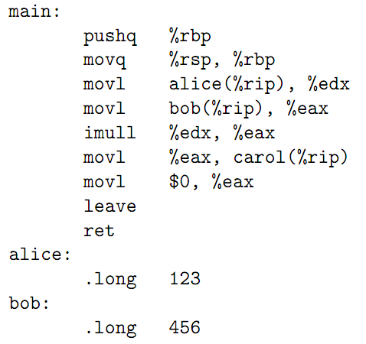
Algorithms
Assembler language
Computer programs when expressed in computer instructions, assembler code, look like this.
Notes:
Computer programs when expressed in computer instructions, assembler code, look like this. So what does this “code” actually do?
4

Slide 5
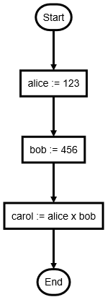
Algorithms
Assembler language
Notes:
Expressed as a flow chart we can see this is simply a program to multiply two numbers.
5

Slide 6
Algorithms
Python
alice = 123
bob = 456
carol = alice * bob
Notes:
Here is the same algorithm written in Python. As you can see the Python script is so much like the flowchart that the flowchart is now redundant.
But before we dismiss flowcharts completely let’s take a look at some more complicated algorithms.
6

Slide 7
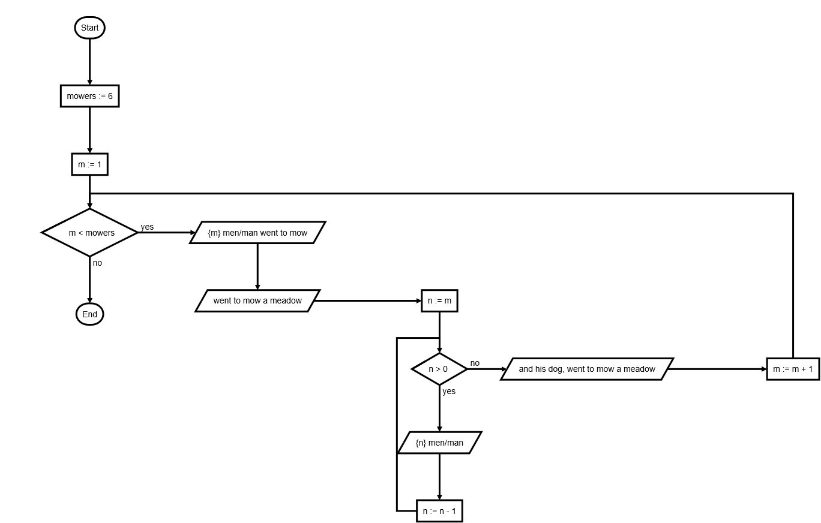
Algorithms
A non-trivial program
So what if we have a problem that’s more complicated than swapping two names, or multiplying two numbers?
Notes:
Flowcharts are not as widely used in computing as they once were.
Programming languages like Python make it easier to express algorithms in text form.
Let’s see how.
7

Slide 8
Algorithms
Went to Mow a Meadow
One man went to mow, Went to mow a meadow,
One man and his dog, Went to mow a meadow.
Two men went to mow, Went to mow a meadow,
Two men, one man and his dog, Went to mow a meadow.
Three men went to mow, Went to mow a meadow,
Three men, two men, one man and his dog, Went to mow a meadow.
Notes:
Went to Mow a Meadow is a children’s counting song which involves counting up, and down. It could presumably continue forever, rather like many tasks given to computers and robots.
8

Slide 9
Notes:
Here is my attempt to convert the script of the song into flow chart. In the next workshop session I’m going to ask you to write a Python program that implements this program.
9

Slide 10
Algorithms
Flowchart symbols
Start and end – circle or rounded
Input and output – parallelogram
Operation – rectangle
Conditional branch – diamond
You don’t have to use these, but it can’t hurt to have a standard.
Notes:
Perhaps the flowchart for the song was a bit more complicated than you might have expected. So here’s a simple example to show what each of the symbols represents.
10

Slide 11
Algorithms
As Python
value = input()
value = value.upper()
if value is 'BYE':
print('Goodbye!')
Notes:
Perhaps the flowchart for the song was a bit more complicated than you might have expected. So here’s a simple example to show what each of the symbols represents.
11

Slide 12
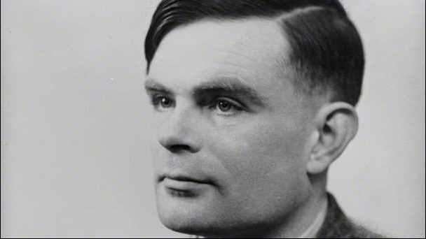
Algorithms
Turing Completeness
A set of rules is Turing complete, or computationally universal, if those rules can be used to simulate any Turing machine.
Alan Turing, mathematician and pioneer of computer science.
Notes:
A system of data-manipulation rules (such as a computer's instruction set, or programming language) is said to be Turing complete or computationally universal if it can be used to simulate any Turing machine.
12

Slide 13
Algorithms
Turing Completeness
It might surprise you to know that we’ve already encountered enough Python to have a Turing complete set of rules.
Conditional branching
Ability to change memory (variables)
Notes:
Now that we can branch, and change values stored in memory, we can – theoretically – create any machine that can be described by an algorithm.
13

Slide 14
Algorithms
Exercise – Went to mow a meadow
What do we need?
Output (print) text
Count up
Count down
Notes:
Now that we can branch, and change values stored in memory, we can – theoretically – create any machine that can be described by an algorithm.
14

Slide 15
Algorithms
Counting and printing
for m in range(4):
print("m is", m)
print("m plus 1 is", m + 1)
print("4 minus m is", 4 - m)
Notes:
Now that we can branch, and change values stored in memory, we can – theoretically – create any machine that can be described by an algorithm.
15

